Slide 1
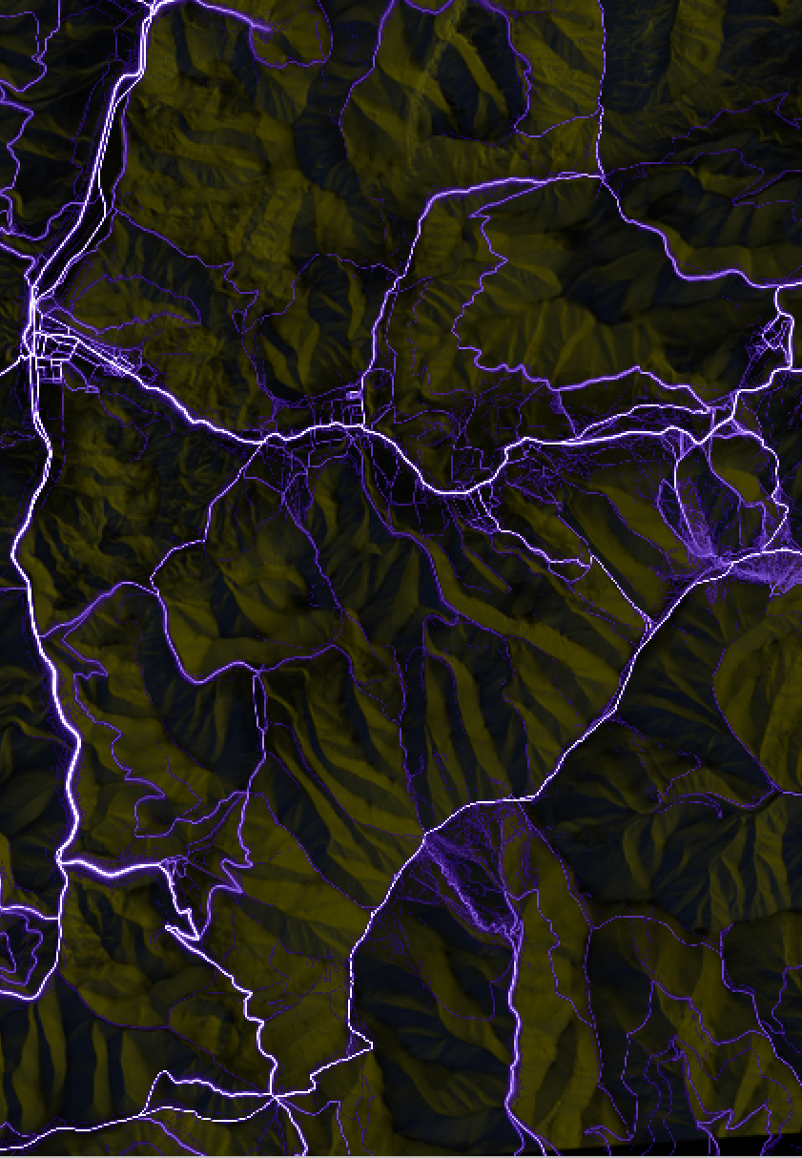
Zdroje mapových dát
Športový klub BY
sportovy.klub.by@gmail.com

Slide 2
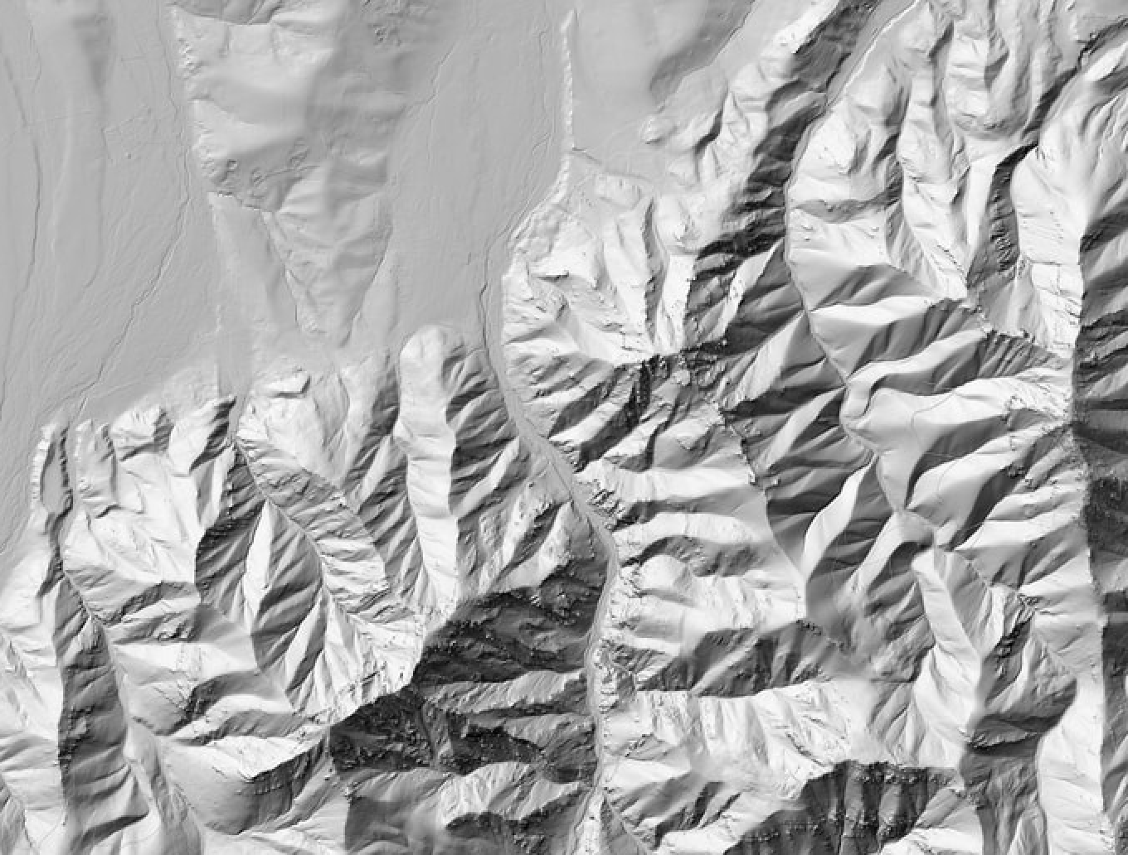
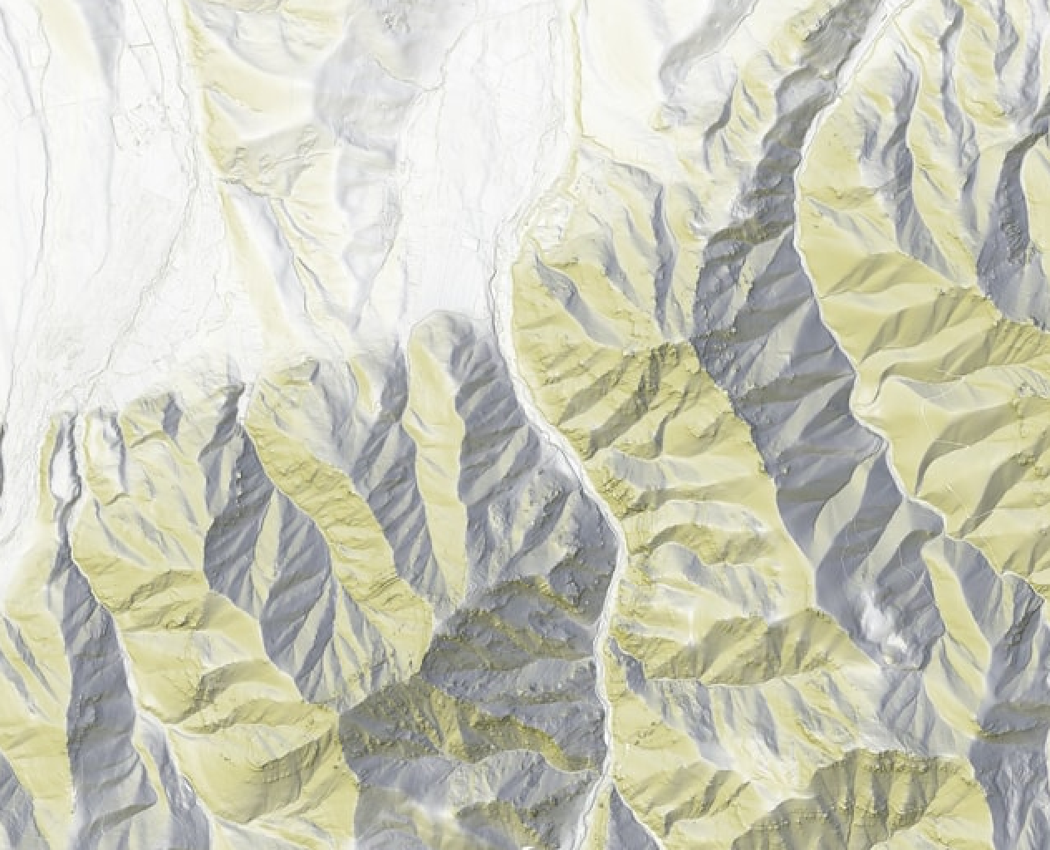

https://dmr5-shading.tiles.freemap.sk/{zoom}/{x}/{y}.jpg
https://dmr5-light-shading.tiles.freemap.sk/{zoom}/{x}/{y}.jpg
https://dmr5.tiles.freemap.sk/{zoom}/{x}/{y}.png

Slide 3
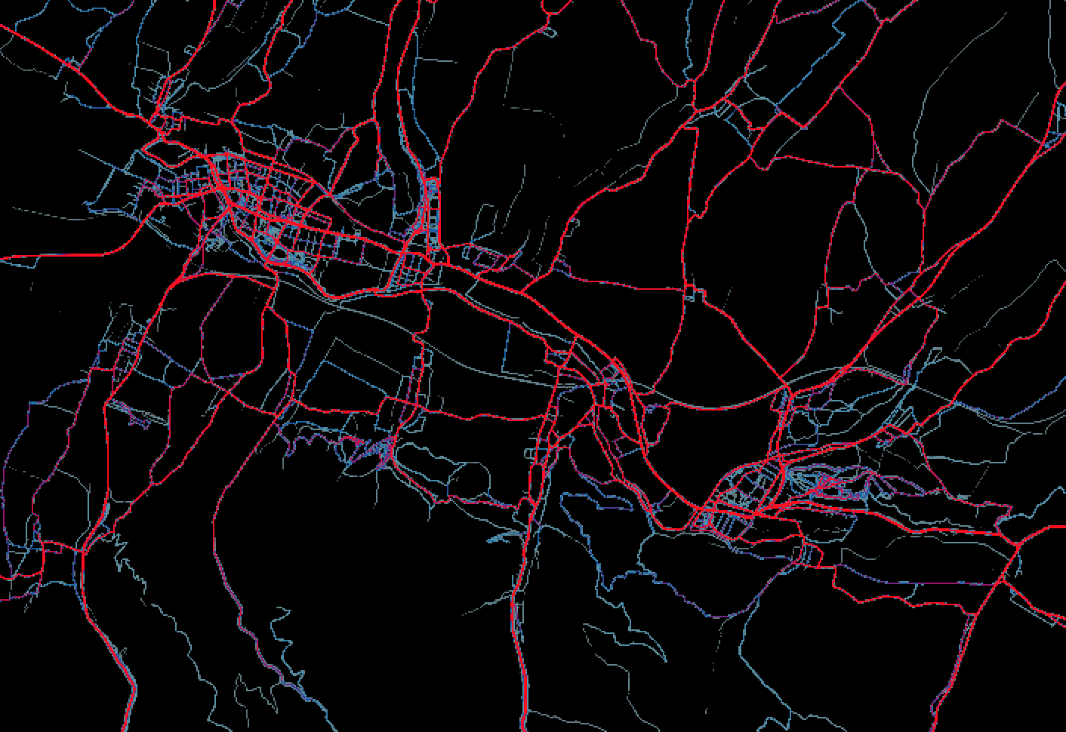
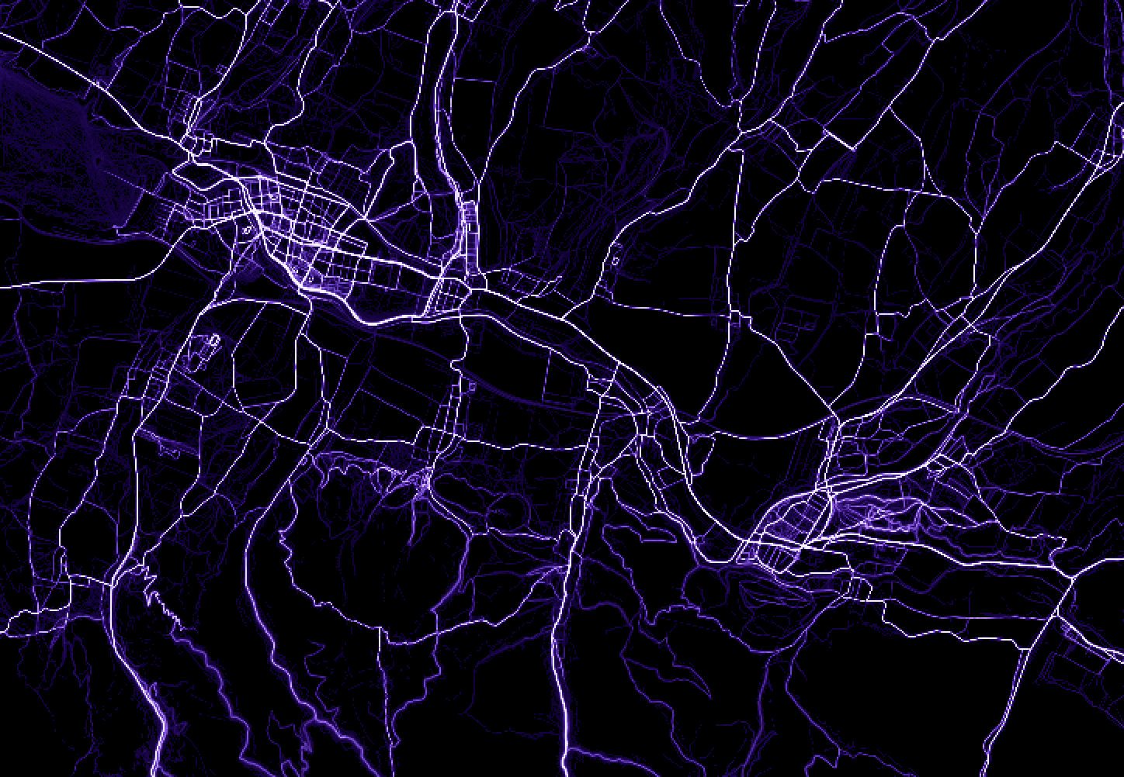
https://heatmap-external-{switch:a,b,c}.strava.com/tiles/ride/bluered/{zoom}/{x}/{y}.png
http://strava-heatmap.tiles.freemap.sk/all/purple/{zoom}/{x}/{y}.png
TODO:

Slide 4
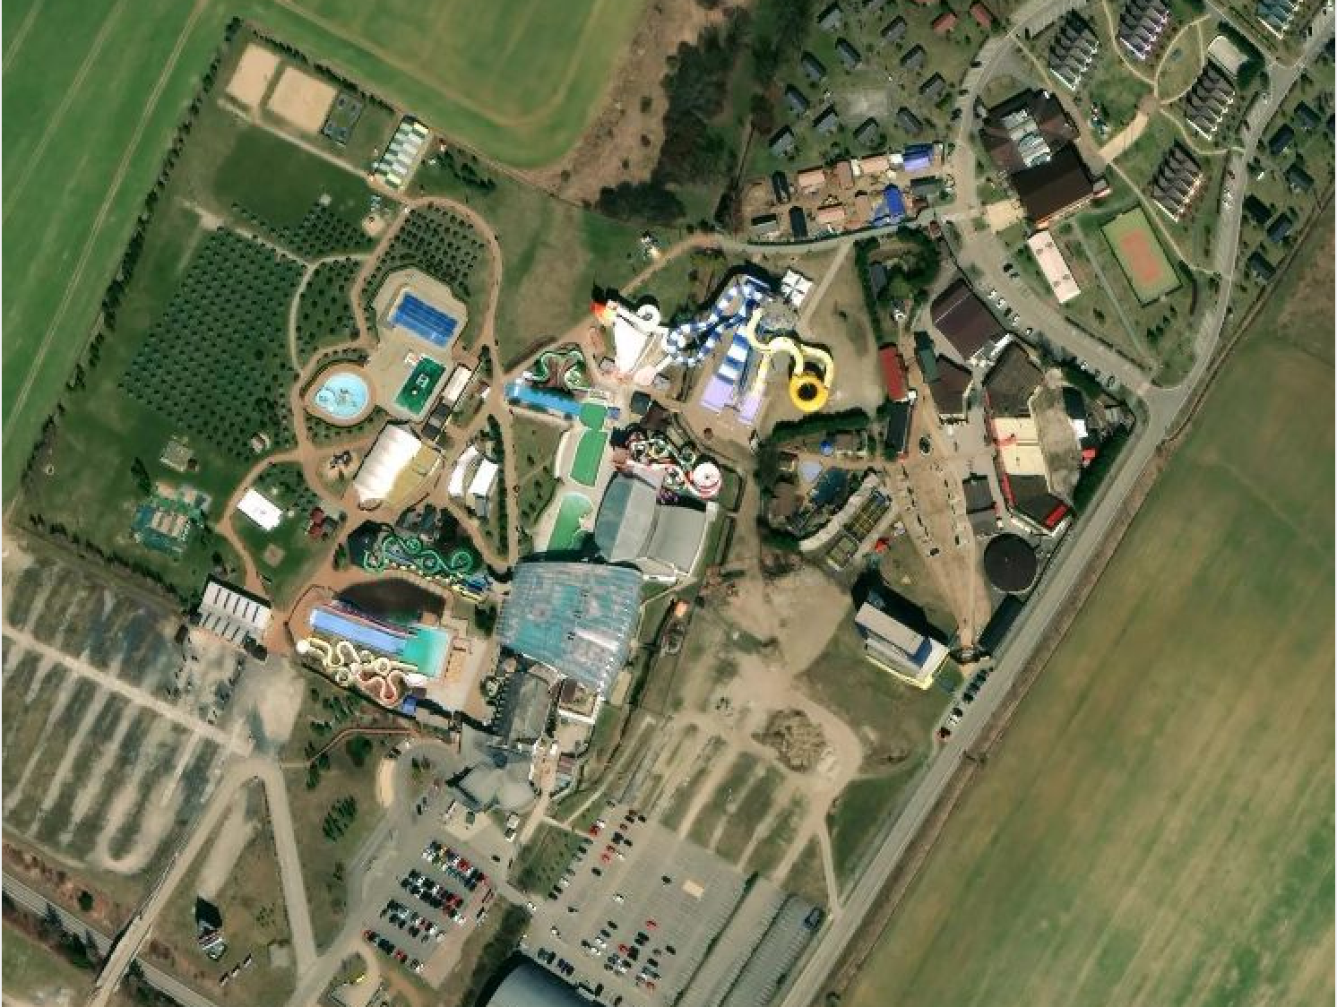
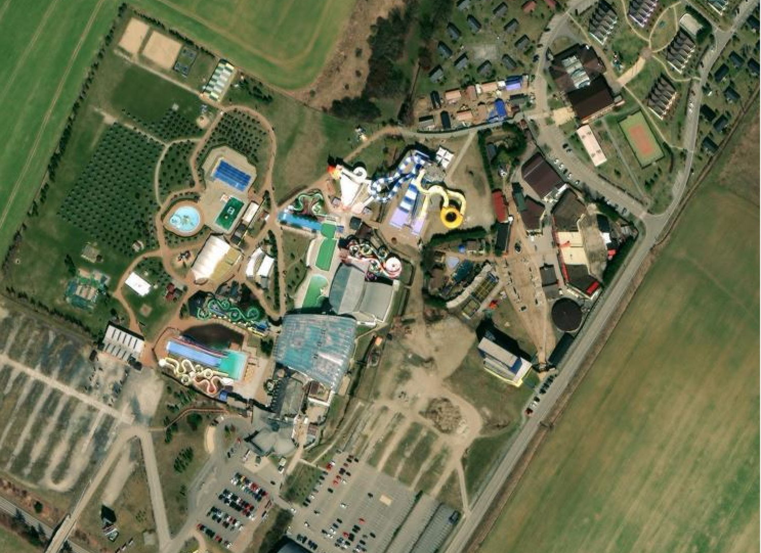
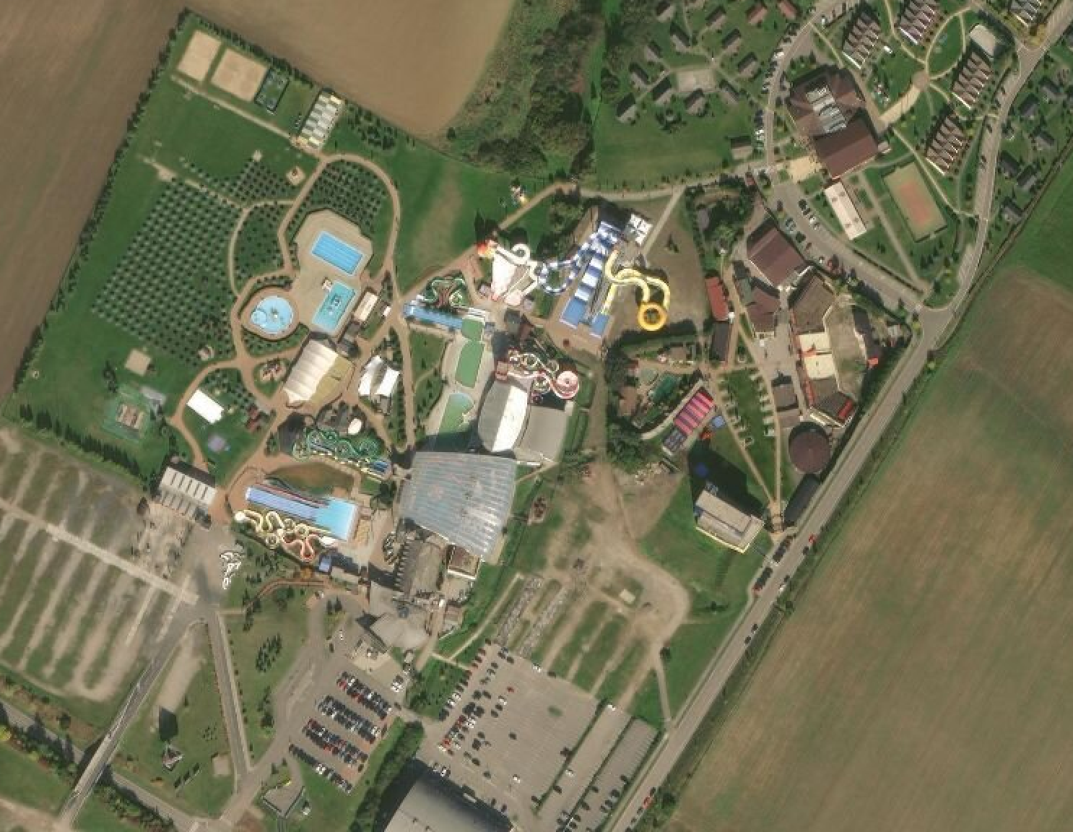
https://{switch:a,b,c,d}.tiles.mapbox.com/v4/mapbox.satellite/{zoom}/{x}/{y}.jpg
https://www.bing.com/maps/
https://clarity.maptiles.arcgis.com/arcgis/rest/services/World_Imagery/MapServer/tile/{zoom}/{y}/{x}

Slide 5
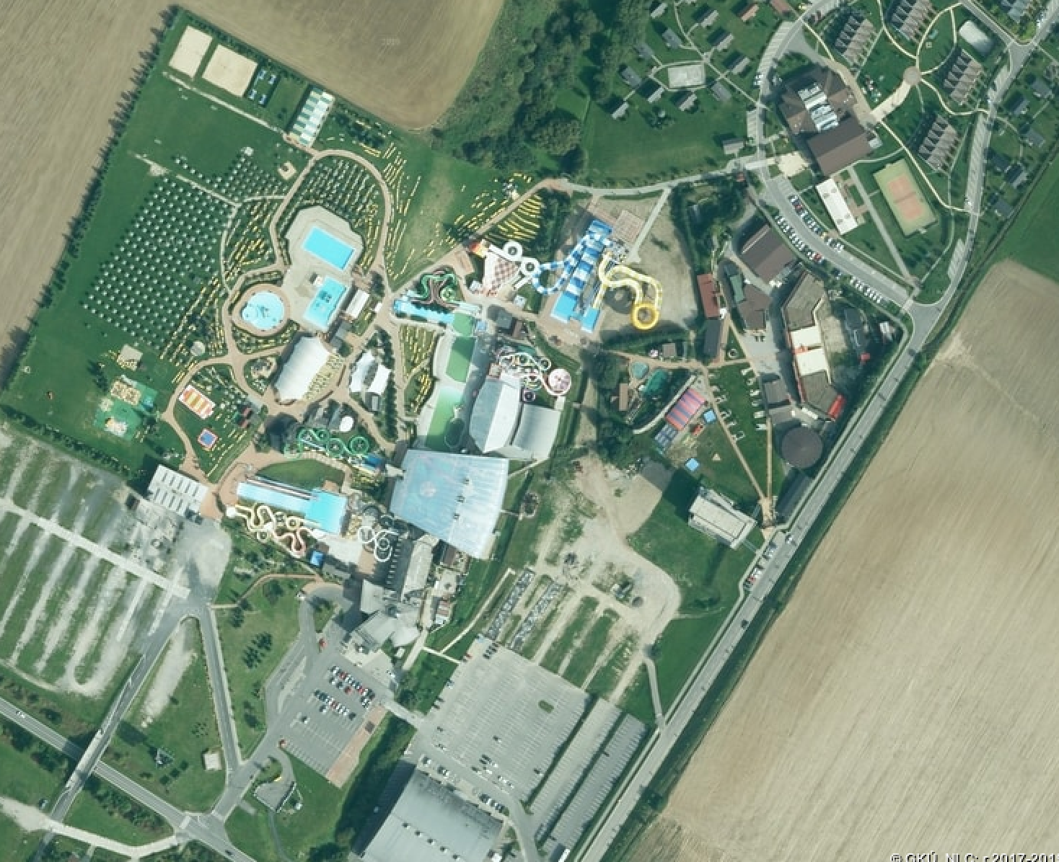

https://ofmozaika.tiles.freemap.sk/{zoom}/{x}/{y}.jpg
TODO
TODO

Slide 6
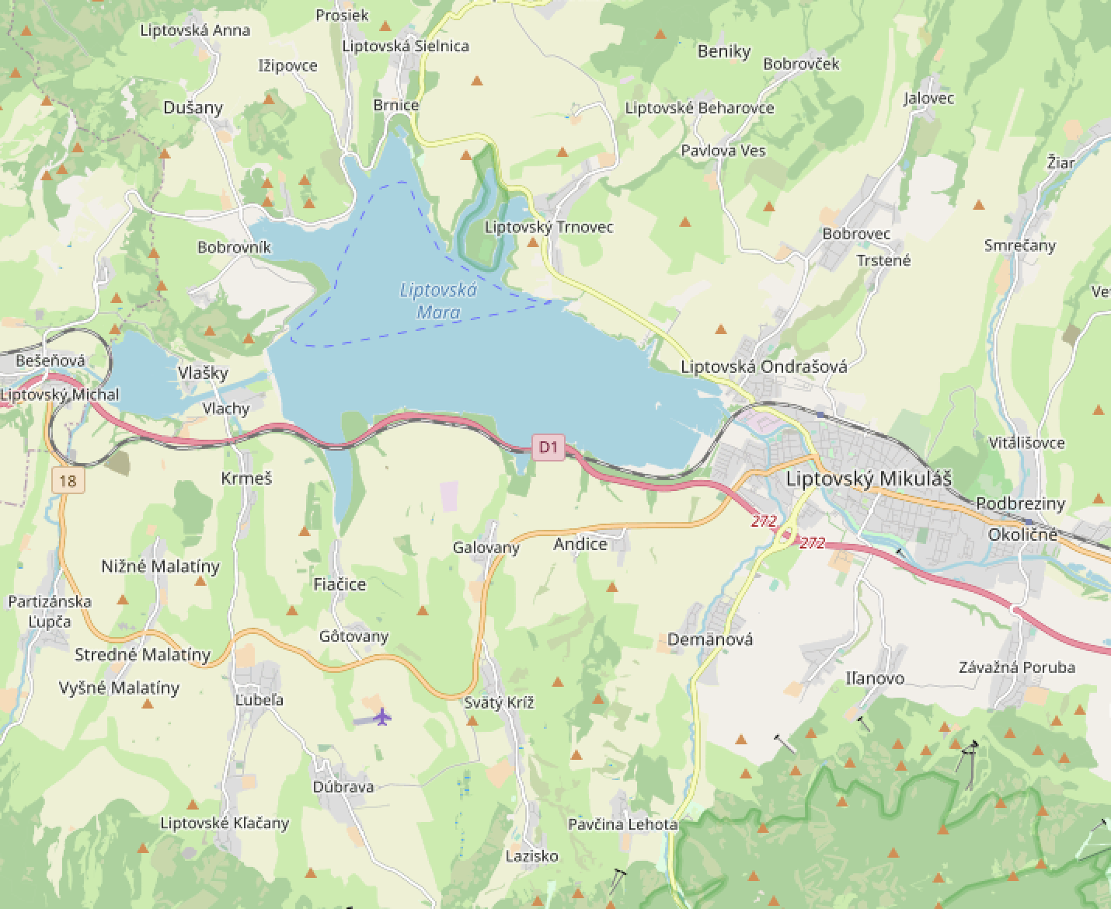
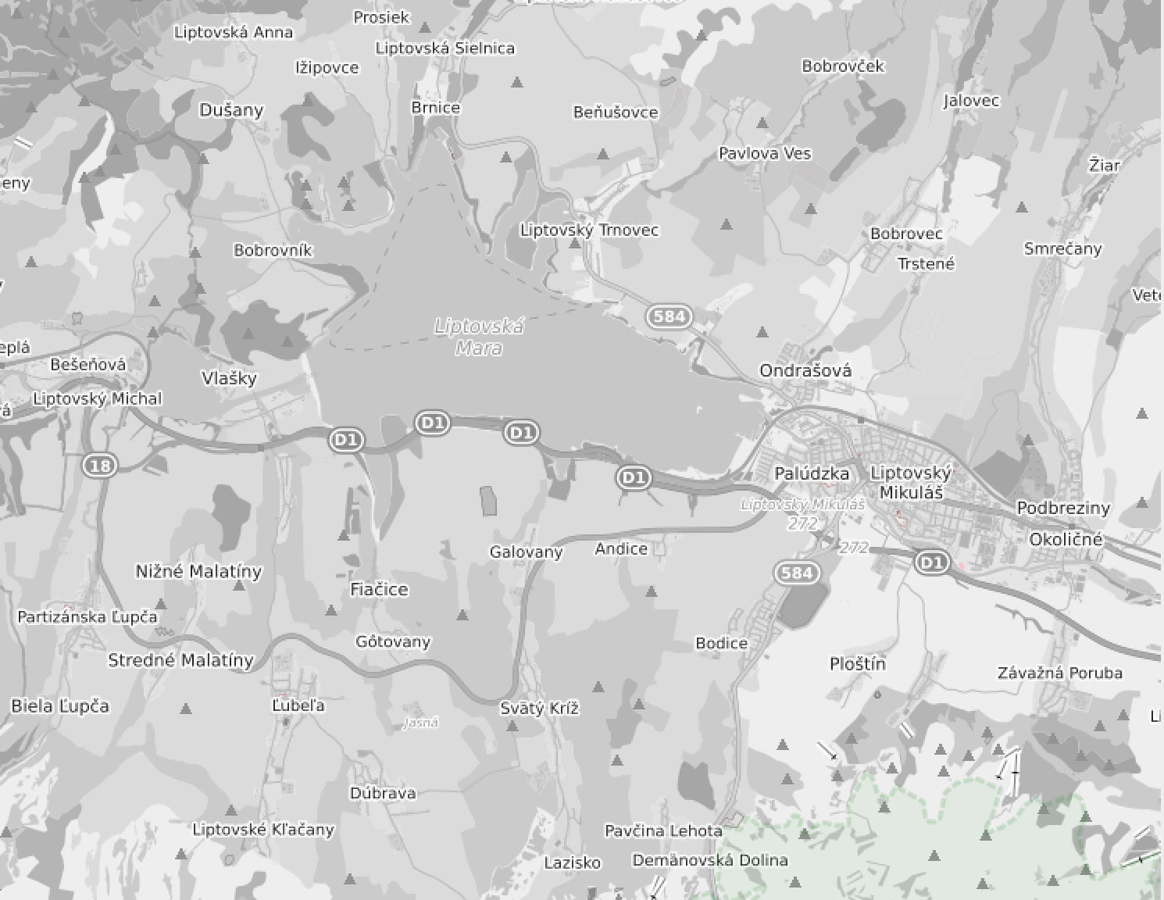
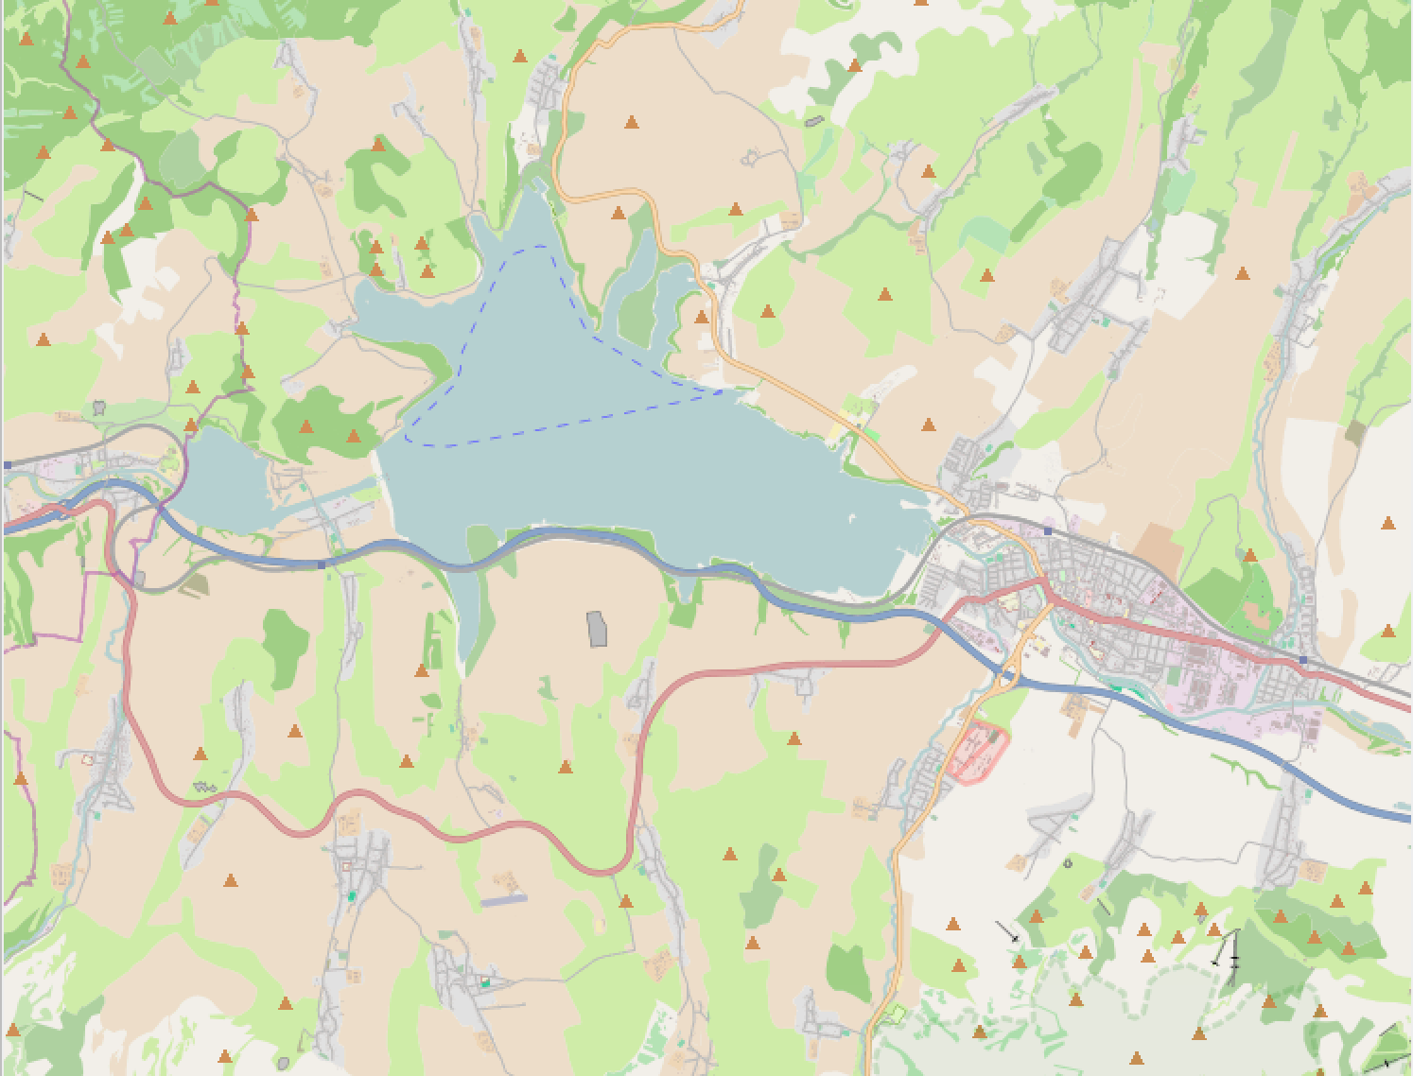
https://tile.openstreetmap.org/{zoom}/{x}/{y}.png
https://tiles.wmflabs.org/bw-mapnik/{zoom}/{x}/{y}.png
https://tiles.wmflabs.org/osm-no-labels/{zoom}/{x}/{y}.png

Slide 7
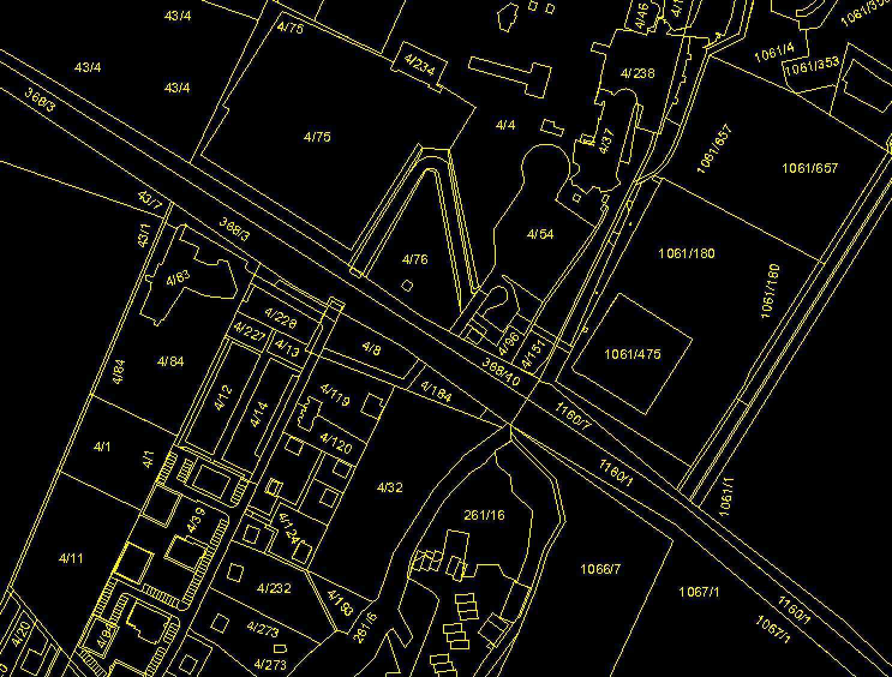
https://kataster.skgeodesy.sk/eskn/services/NR/kn_wms_orto/MapServer/WmsServer?version=2.0.0&service=WMS&request=GetCapabilities
TODO
TODO

Slide 8

TODO
TODO
TODO

